Slide 1
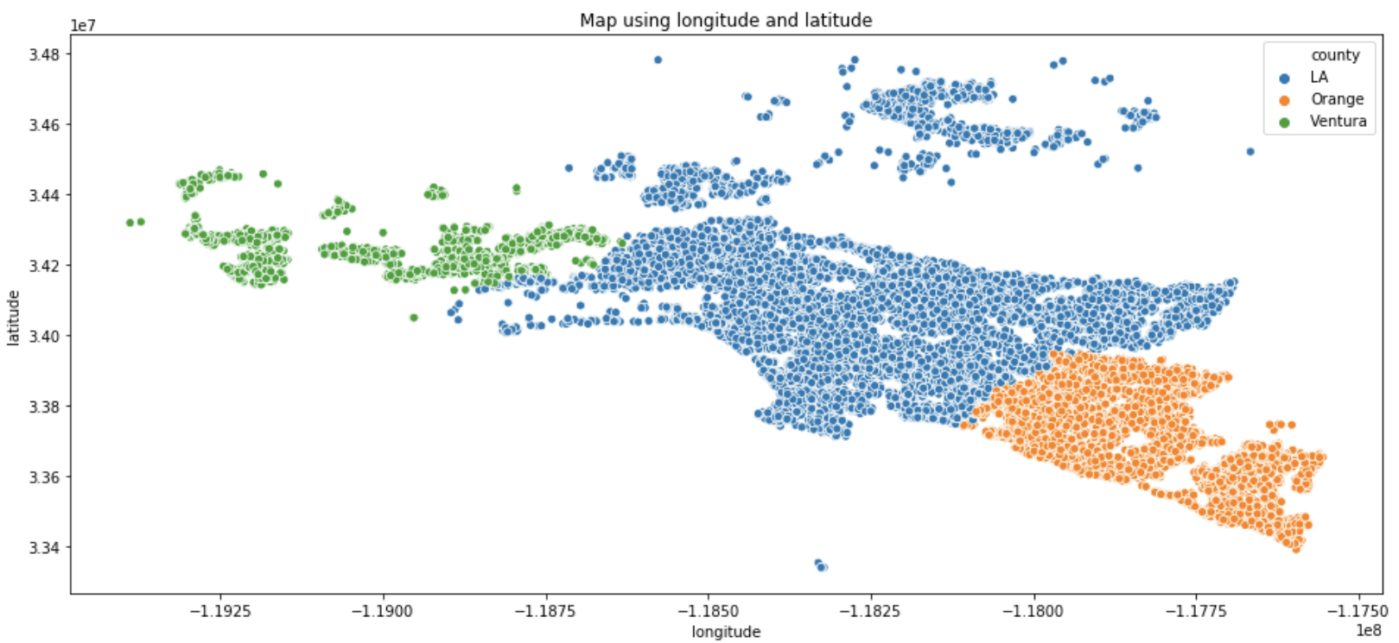
Property Tax Value Prediction Model
Zillow Regression Project
10/8/2020
CY Data Services - Corey Solitaire, Ryvyn Young

Slide 2
Agenda
Executive Summary
Tax Rate Additional Information
Data Pipeline Process
Exploration Key Insights
Modeling Results Summary
Conclusions

Slide 3
Executive Summary
Best Performing Model:
Second Iteration (5 Features, degree = 2)
Features = Bedrooms, Bathrooms, Finished ft², Garage, Zip-category
Model = Polynomial Feature Model
Avg. RMSE of $447039.41
31% Improvement over baseline
Effect On Model - RFE Features Improve Performance
Best Features for Modeling:
Bedroom count
Bathroom count
Finished square footage
Garage
Categorical zip code
Hypothesis Testing Results:
Chi Squared Test for Independence: bedrooms and bathrooms
Rejected Null: 95% Confidence Variables show dependence
Independent T-Test: Preformed on fireplace and total square feet
Rejected Null: 95% Confidence that there is a difference (in square footage) between houses with or without a fireplace

Slide 4
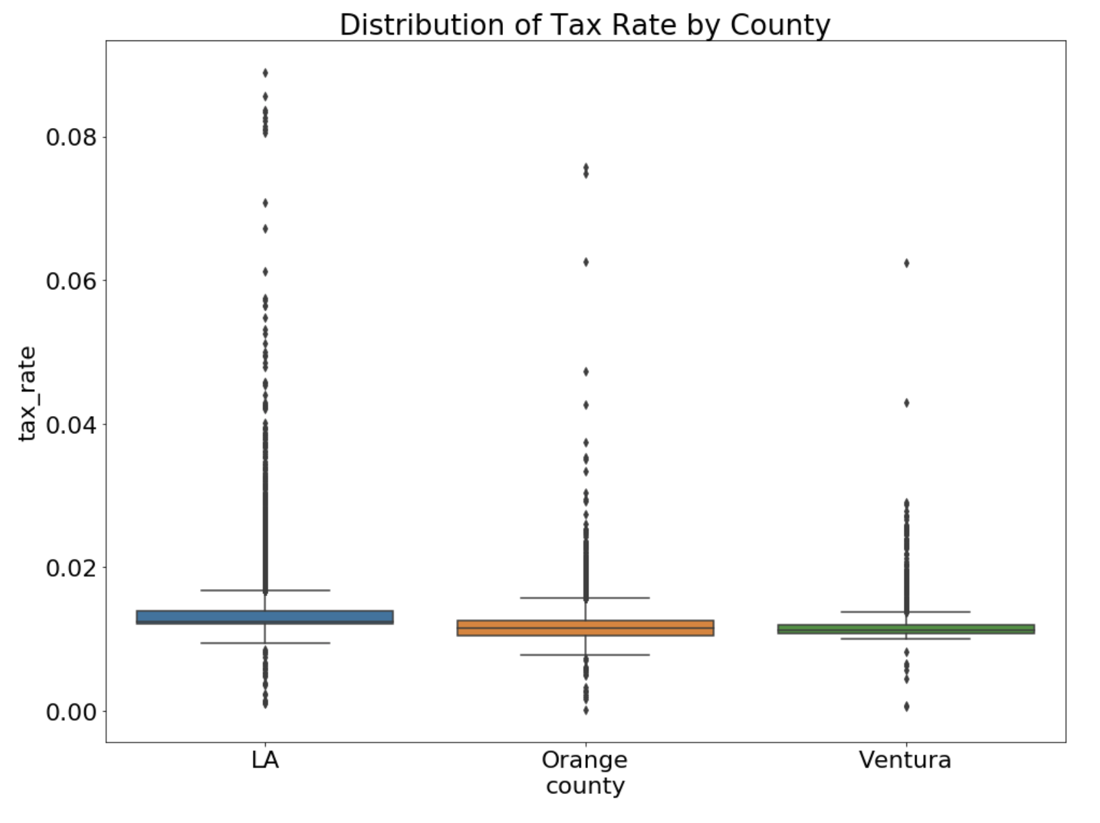
Tax Rate -
Additional Information
What rate do most properties sit around?
1st quartile tax rate percentage: 1.16%
3rd quartile tax rate percentage: 1.35%
The difference of these (IQR) is: 0.19%

Slide 5



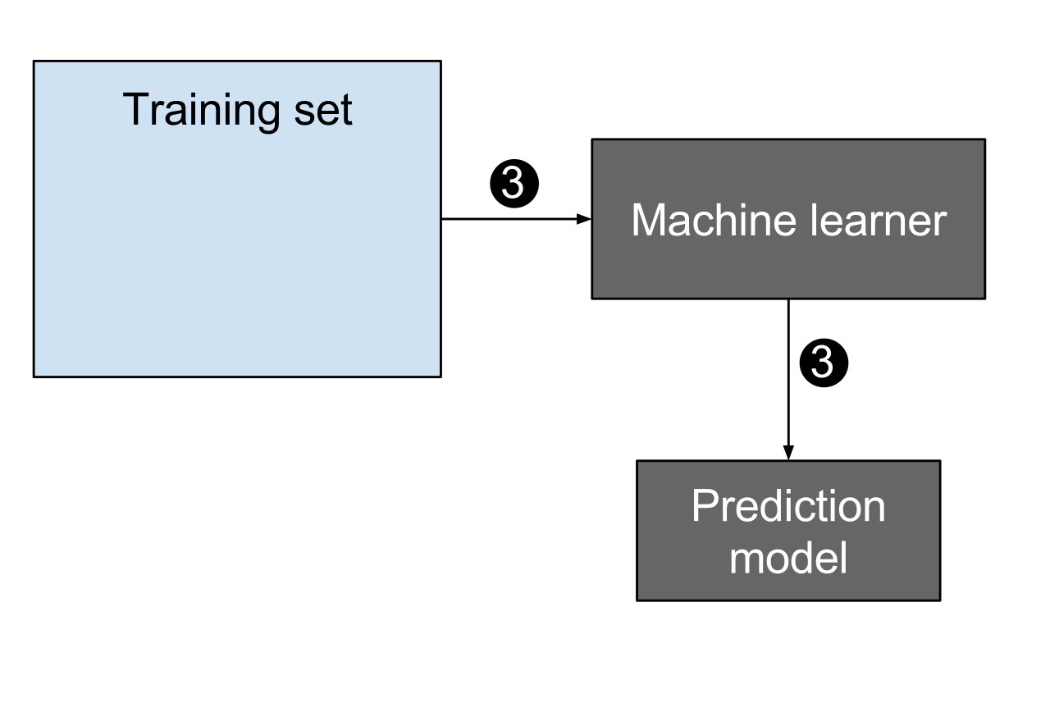

Data Pipeline Process
Create ML model to predict tax assessed value of single properties in LA, Orange, Ventura California counties
Determine tax rate by county and distribution of rates
Acquire and clean data obtained using mySQL
Determine features and resolve outliers
Prepare data for exploration and modeling
Visualize features
Hypothesis testing
Feature significance/validation testing
Create 4 ML regression models
Evaluate performance
Iterate through additional models
Main Notebook
Additional Information Notebook
Slide deck
Readme
GitHub repo

Slide 6
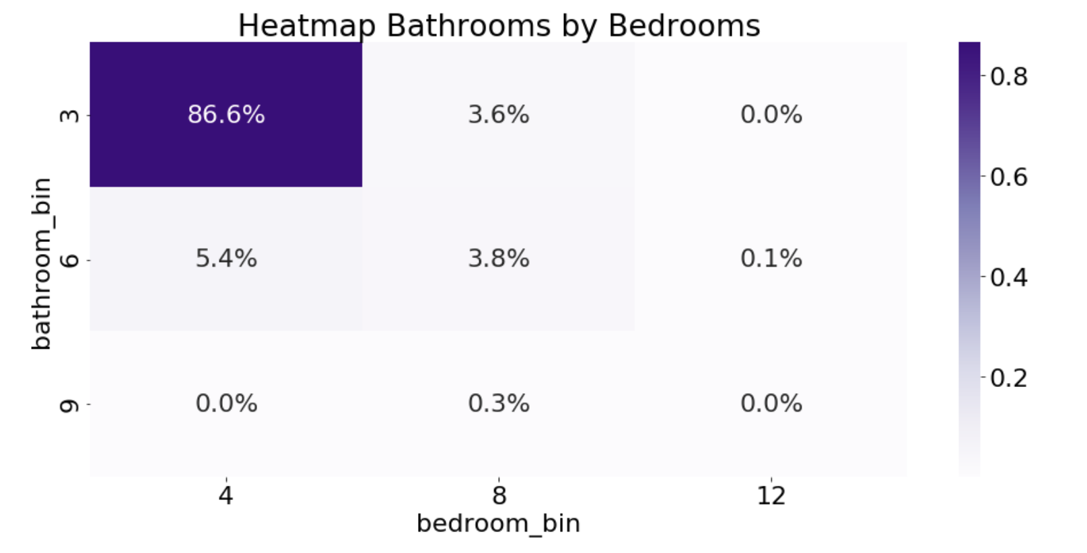
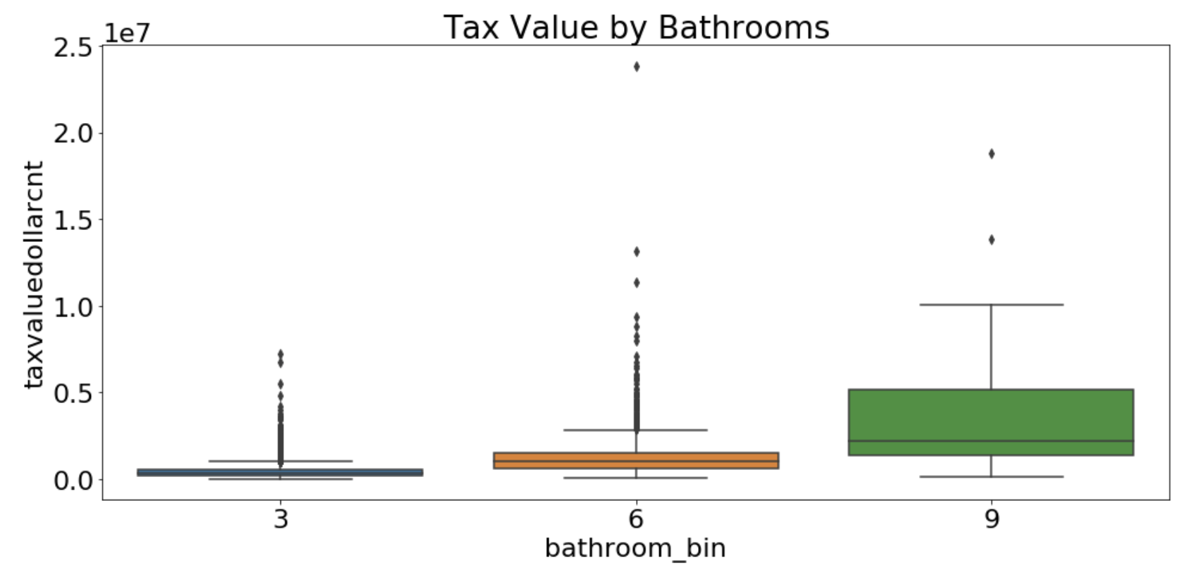
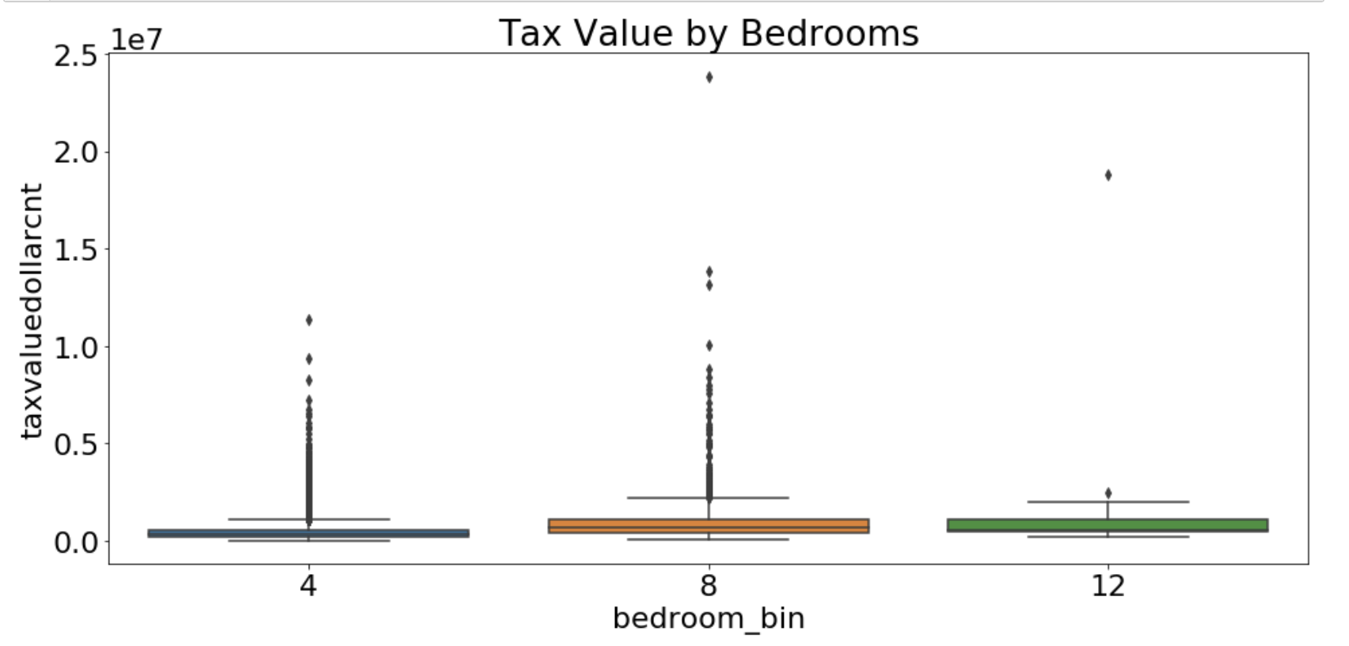
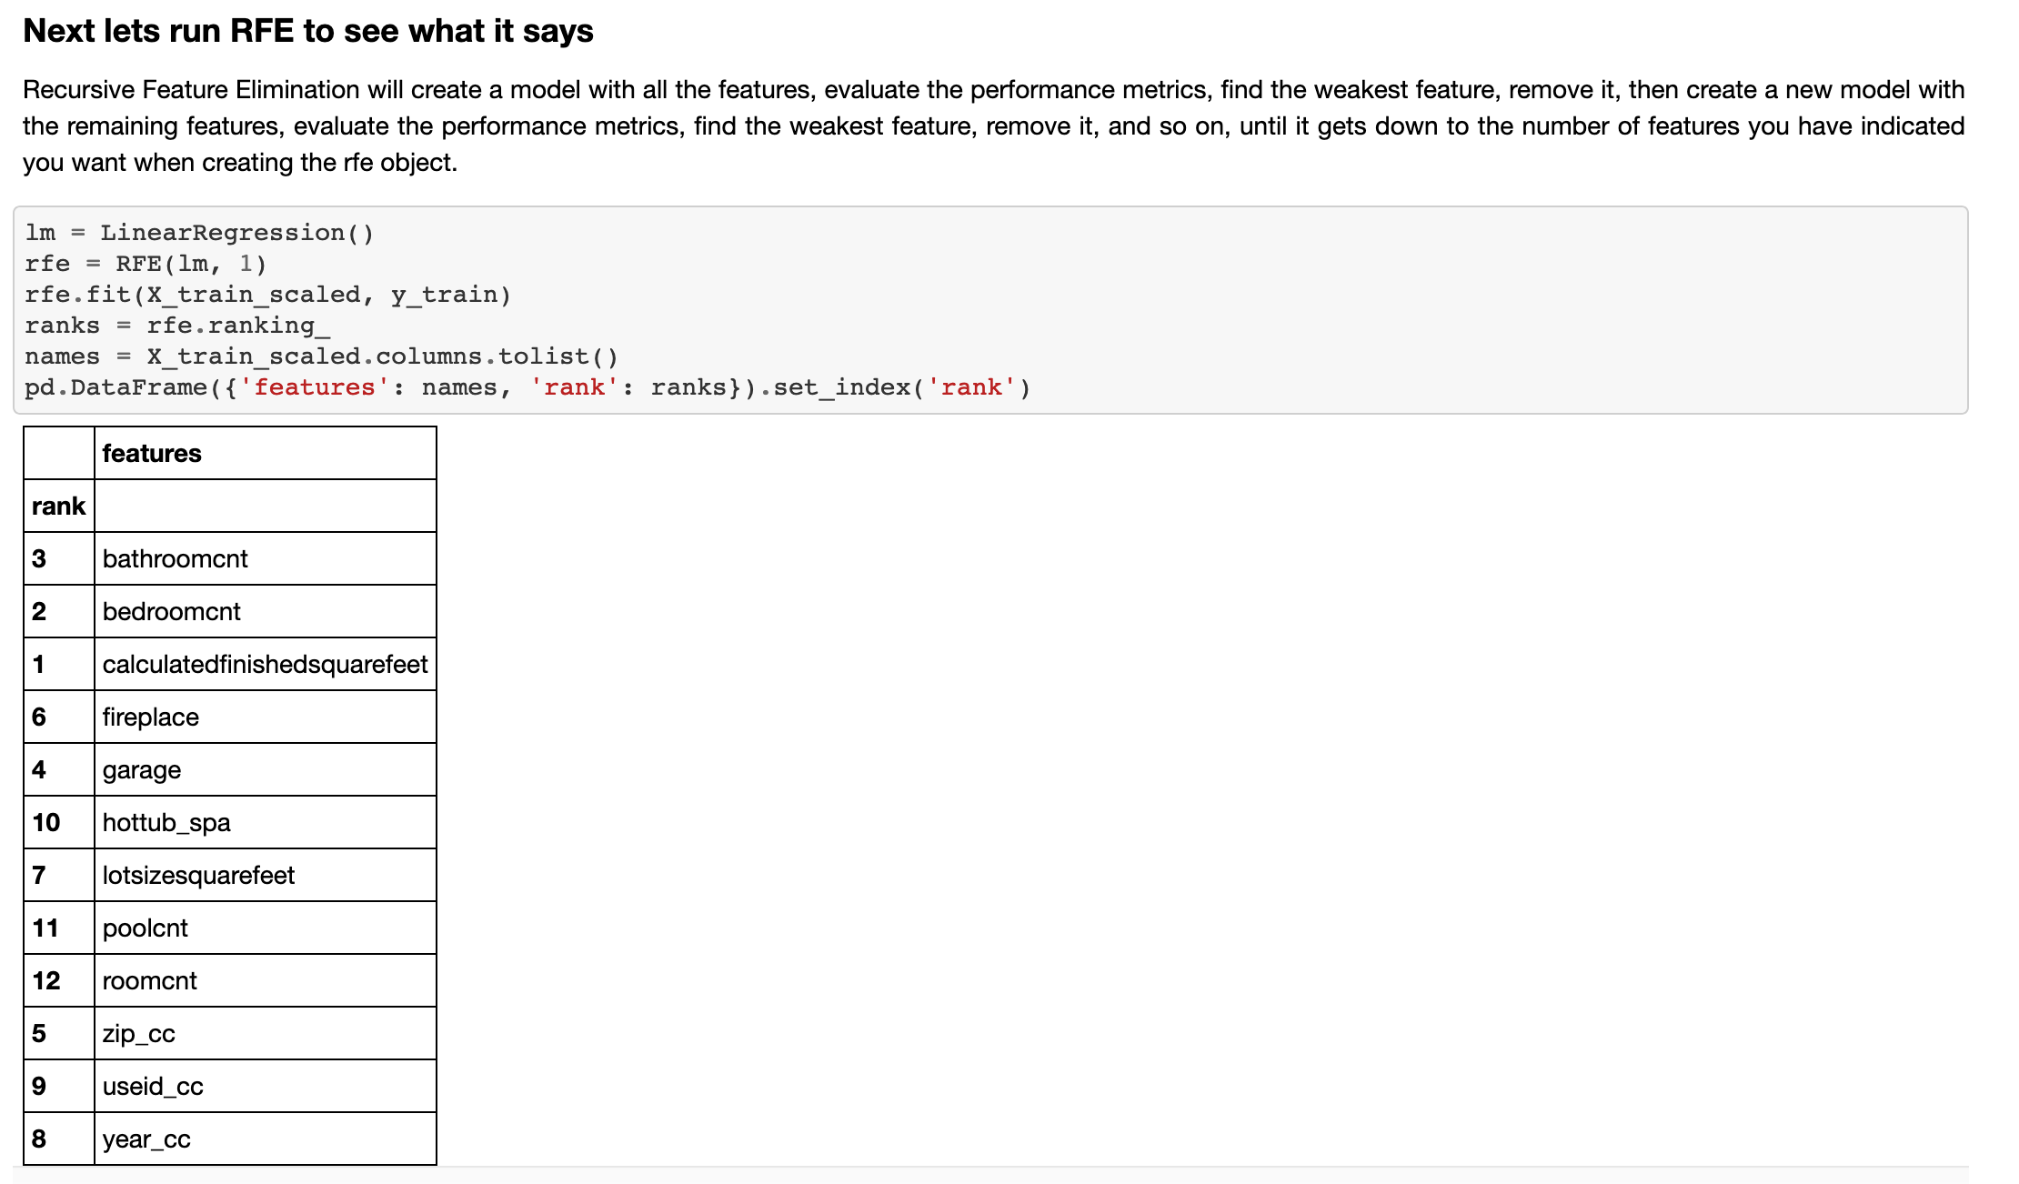
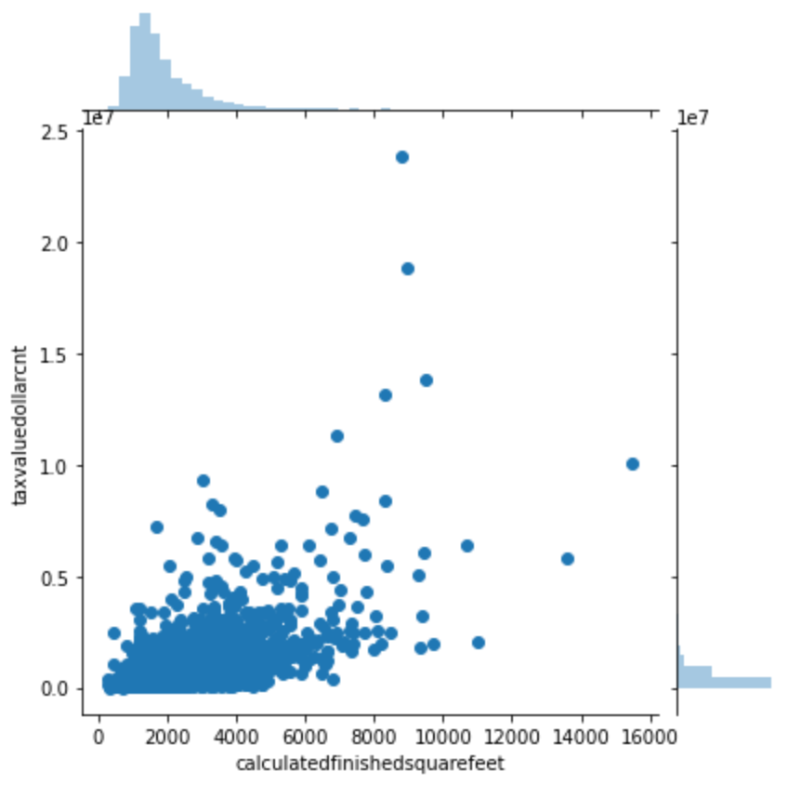
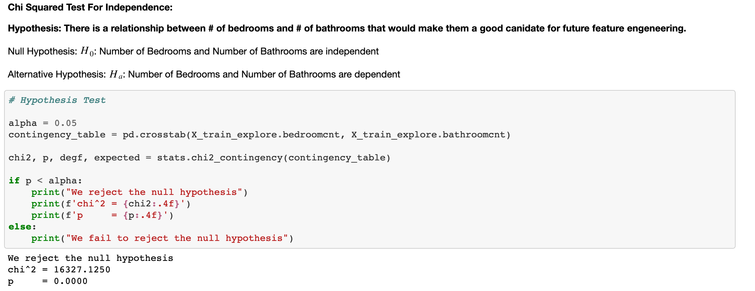
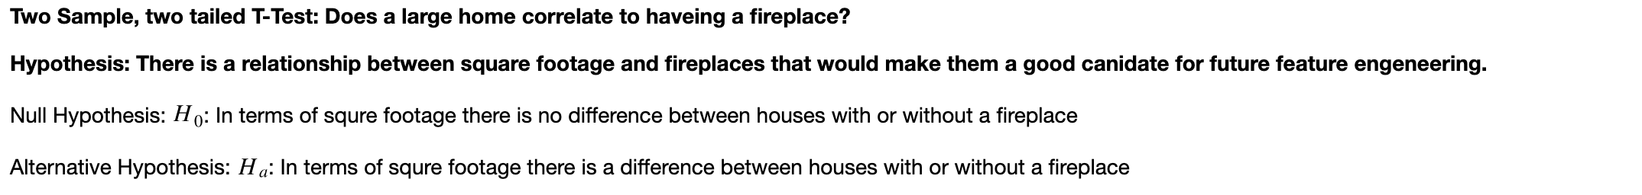
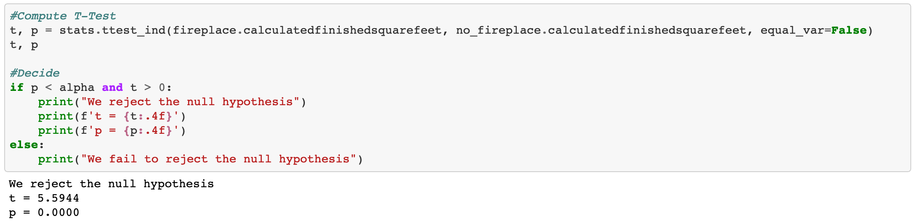
Exploration
Key
Insights
Hypothesize
Visualize
Test
Hypothesize
Visualize
Test
Hypothesize:
Do our variables have a statistically significant relationship with our target ?
Tax Value by Square Footage
Statistical Testing:
Chi Squared Test of Independence
2 Sample T-Test
RFE

Slide 7
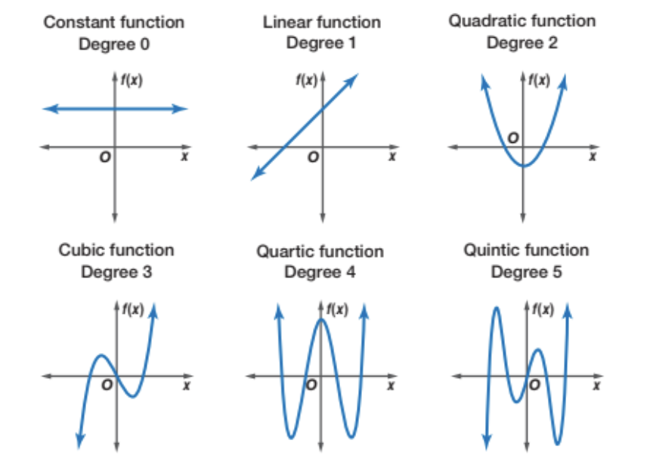
Modeling Results Summary
Modeling: (3 Iterations)
4 model types: Linear Regression, LassoLars, Polynomial Features, Tweedie Regressor
Target = Tax Value Amount
First Iteration (3 Features, degree = 2)
Features = Bedrooms, Bathrooms, Finished ft²
Best Model = Polynomial Feature Model
Avg. RMSE of $464997.75
28% Improvement over baseline
Second Iteration (5 Features, degree = 2)
Features = Bedrooms, Bathrooms, Finished ft², Garage, Zip-category
Model = Polynomial Feature Model
Avg. RMSE of $447039.41
31% Improvement over baseline
Effect On Model - RFE Features Improve Performance
Third Iteration (5 Features, degree = 5)
Features = Bedrooms, Bathrooms, Finished ft², Garage, Zip-category
Model = Polynomial Features Model
Avg. RMSE of $442704.79
31% Improvement over baseline
Effect On Model - Overfit, loss of predictive power on unseen data

Slide 8


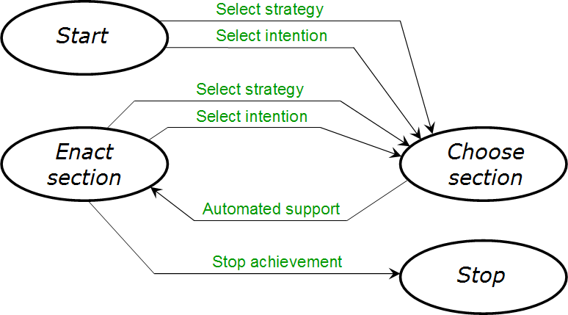
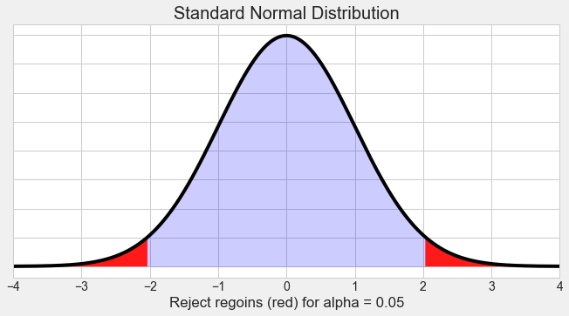

Conclusions
&
Next Steps
Top Performing Model
31% improvement over baseline
5 features
2 degree Polynomial
Additional Information
Southern California
Bulk of properties tax rates between 1.16% and 1.35%
Model Iteration
Varied model type
Varied # features
Varied hyperparameters
Hypothesis Testing
Chi² and Independent T-test
Rejected both null hypothesis
Further reduce outliers in tax rate
Feature engineering: combine features: bedroom/bathroom as single feature?

Slide 9
Appendix
Link to CY Data Services Repository for this Project
zillow_regression_project
List of Domain Knowledge website research
https://www.investopedia.com/terms/h/housingunits.asp
https://en.wikipedia.org/wiki/FIPS_county_code
https://www.nrcs.usda.gov/wps/portal/nrcs/detail/national/home/?cid=nrcs143_013697

